Slide 1
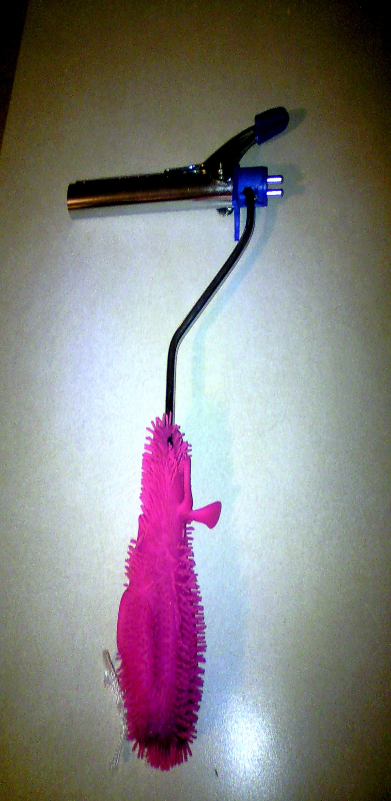
Pam Eckert ota 210 November 12, 2012
My adaptive equipment
TIOLET AIDE

Slide 2
Target population and purpose
The elderly
Provides assistance with independent hygiene
Aides those with limited upper extremity ROM, reach, and dexterity
This would also be idea for individuals suffering from: generalized weakness, strokes, shoulder limitations, obesity, etc.

Slide 3
PRECAUTIONS
MAY NOT BE SUITABLE FOR PERSONS WITH LITTLE TO NO SENSATIONS IN PERI/ANEL AREA (ONE WOULD NEED TO KNOW THE AMOUNT OF PRESSURE BEING APPLIED WHEN USING DEVICE TO AVOID INJURY)
WHEN USING THE DEVICE ALWAYS MAKE SURE THERE IS ENOUGH TOILET PAPER ON THE CLIP TO AVOID THE POSSIBILITY OF SCRAPING SENSITIVE AREAS
ENSURE PROPER CLEANING OF DEVICE AFTER EACH USE TO AVIOD THE SPREAD OF GERMS/INFECTIONS
CHECK FOR WEAR AND TEAR OF DEVICE FREQUENTLY

Slide 4
Materials list and cost
Small paint roller $ 2.00
(discard the roller after purchase)
End of an old curling iron $0.00
(preferably detachable kind)
Rubber stretchy ball for handle $1.00
(optional for better grip)
Screw driver (4 way) & Knife $0.00
TOTAL COST $3.00
* All items were purchased at local Dollar General Store *

Slide 5
Directions for Fabrication of Device
STEP 1
Purchase a small paint roller and discard the roller, leaving you with just the metal portion and plastic handle
STEP 2
Take the end of an old curling iron (clip end) detach and unscrew the part that was holding it on to the bottom portion or handle; keep the screws and the small plastic piece that comes off you will need them later
STEP 3
Cut a small notch in the side of the plastic end of the curling iron (not the metal end) below the clips; in doing this it will allow the curling iron to fit on to the paint roller
STEP 4
Slide the curling iron onto the metal end of the paint roller; now reattach the small plastic piece to the clip end with the screws. There will be some movement this is what you want.
STEP 5 (OPTIONAL) for better grip
Cut a small slit in a rubber stretchy ball and slide it over the plastic handle of the paint roller. Add a string to hang it up and now your own personal toilet aide is complete

Slide 6
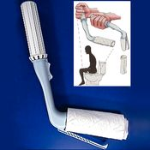
Original inspired Device
Self Wipe Toilet Aide
Cost: $ 66.99
www.pattersonmedical.com

